Slide 1
Data Visualization and Dashboards with Tableau
Sarabjit Matharu
Lighthouse Labs

Slide 2
Option 1: Standard Final Project
Canadian Open Data portal. The files in the folder are:
Weekly earnings from 1.1.2001 to 15.4.2015 (weekly_earnings - CSV)
Housing constructions from 1955 to 2019 (real_estate_numbers - CSV)
House prices from 1.1.2005 to 1.9.2020
(real_estate_prices - EXCEL)
Housing_price_index from November 1979 to September 2020
Office_realestate_index from November 1979 to September 2020
Consumer index from November 1979 to September 2020

Slide 3
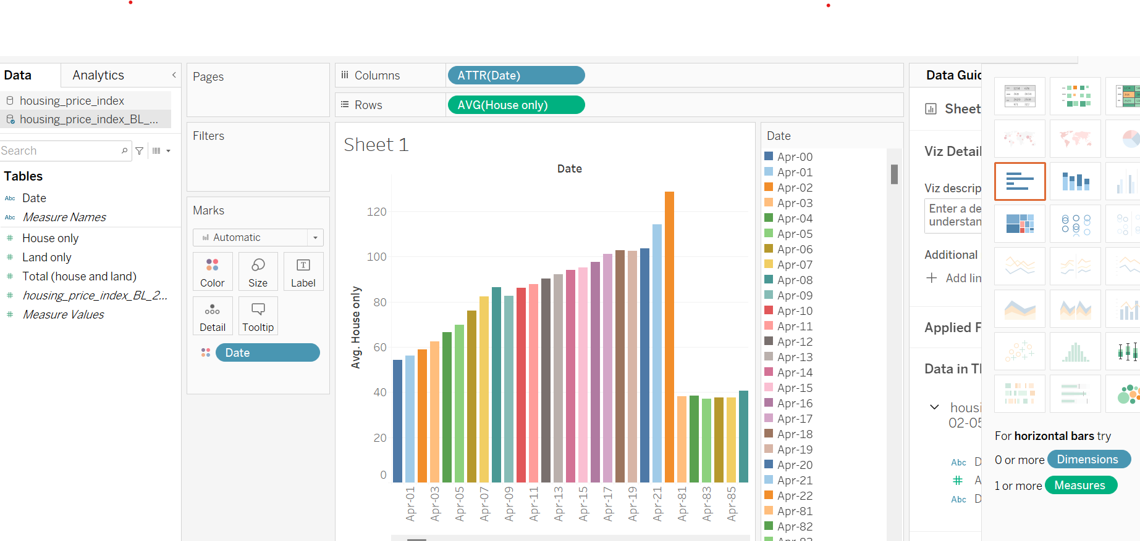
Show the trend of house prices across Canada in the last 40 years (table housing_price_index).

Slide 4
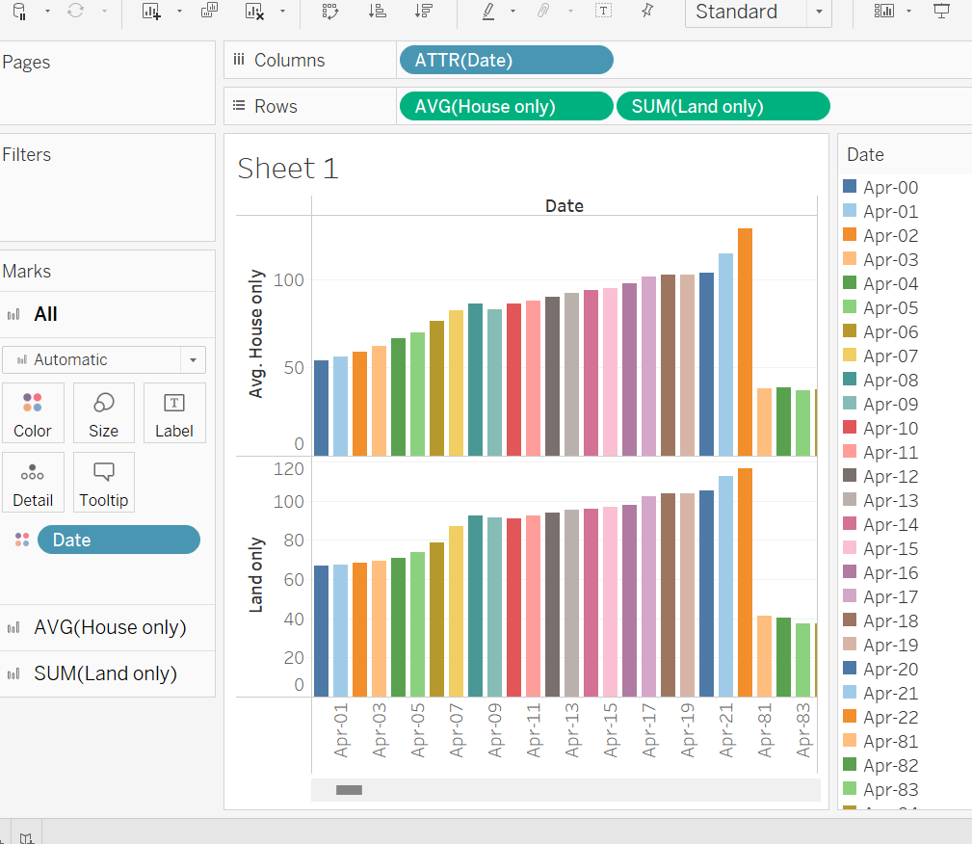
Show the trend of house prices across Canada in the last 40 years (table housing_price_index).

Slide 5
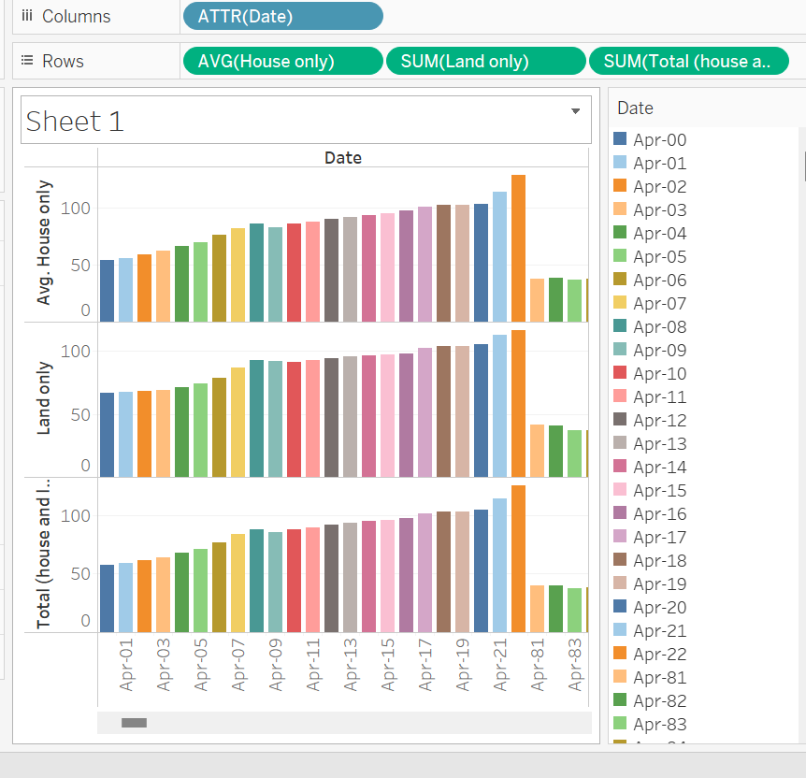

Slide 6
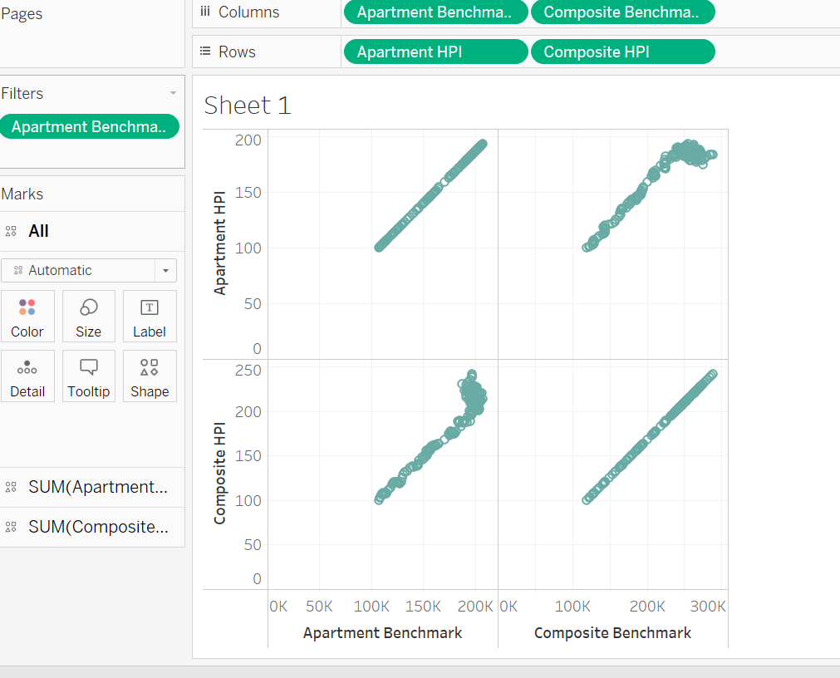
Compare the trend after 2005 with actual benchmark prices in table real_estate_prices to see if there are any differences.

Slide 7
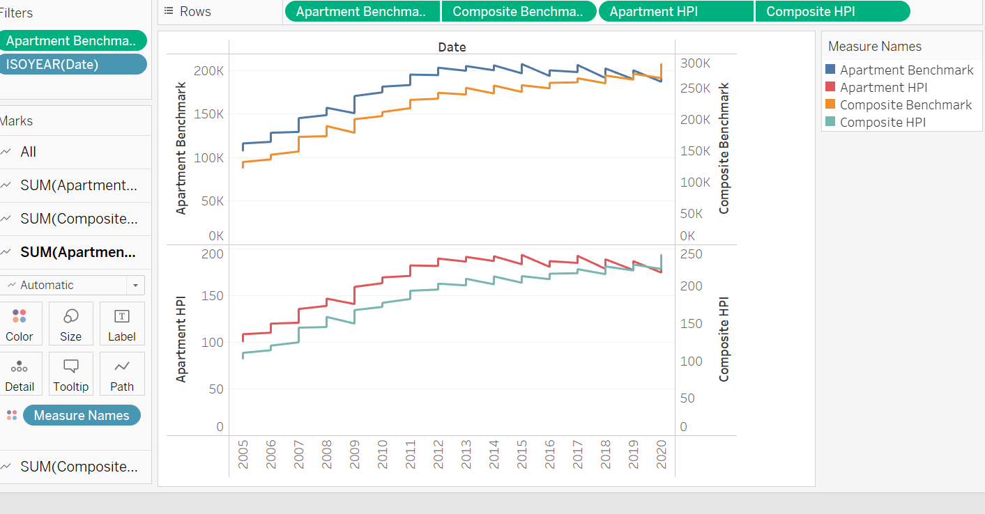
A comparison is done between actual & benchmark values

Slide 8
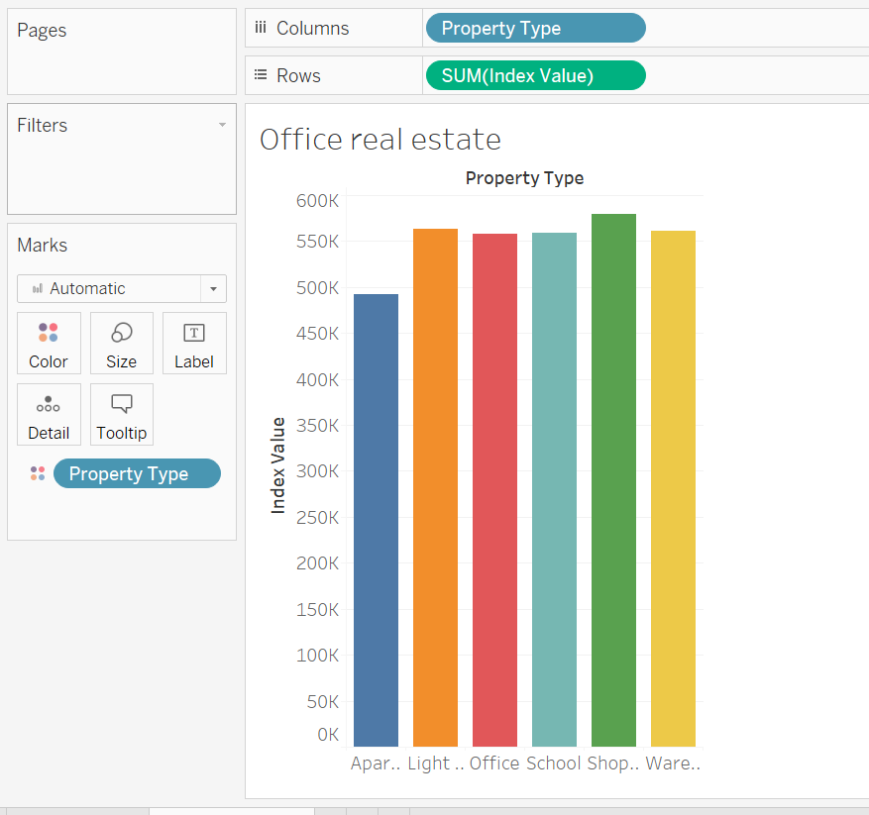
Compare this trend with the trend of office prices. Which one is getting more expensive, faster?

Slide 9
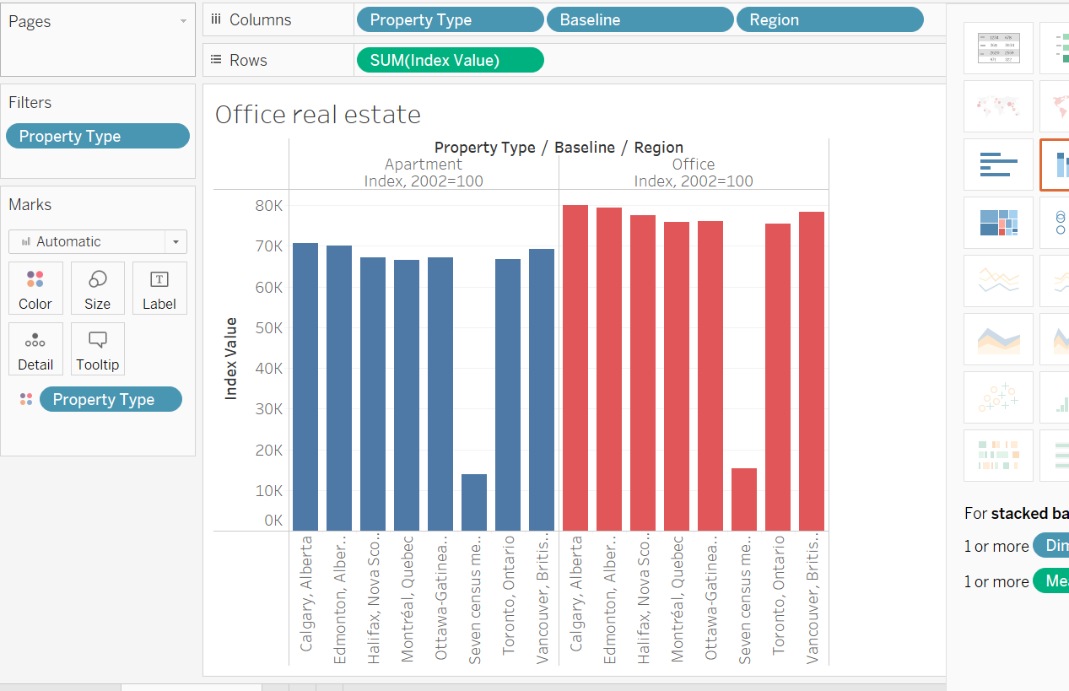
A comparison is done between residential & office real estate and it was found out that prices for offices are getting expensive faster.

Slide 10
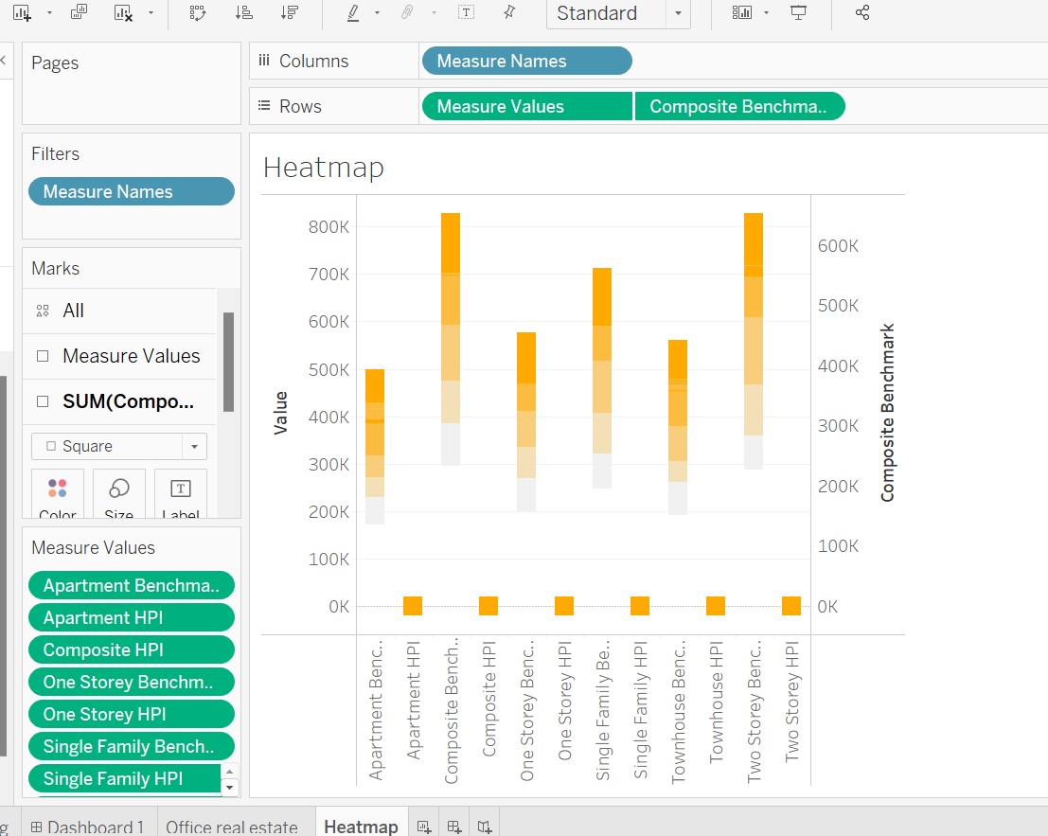
Create a heatmap of Canada with current house prices for each available district.

Slide 11
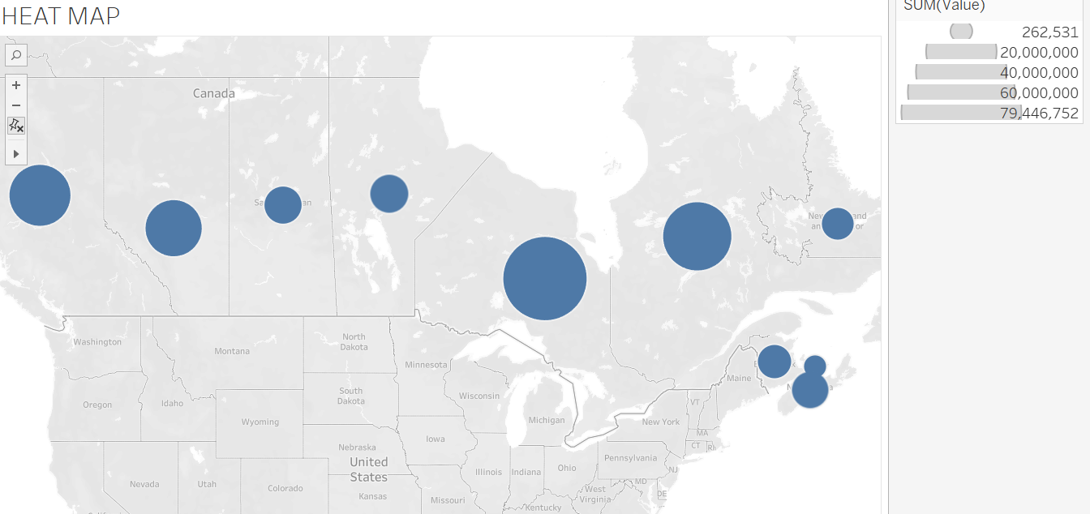
Heat Map with house prices

Slide 12
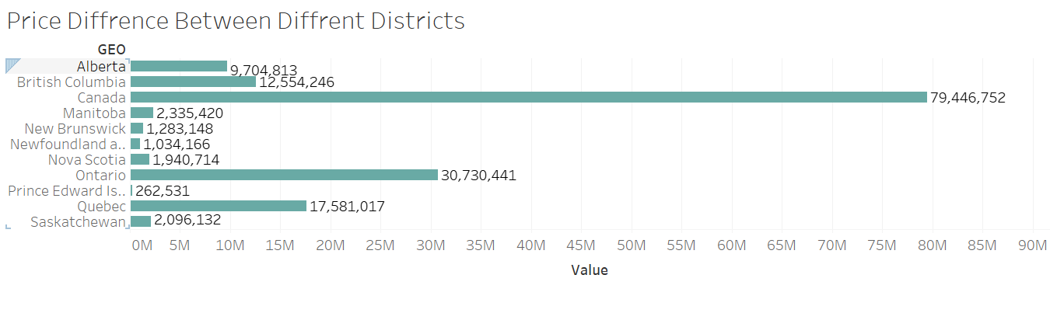
Are the price differences between different districts increasing?

Slide 13
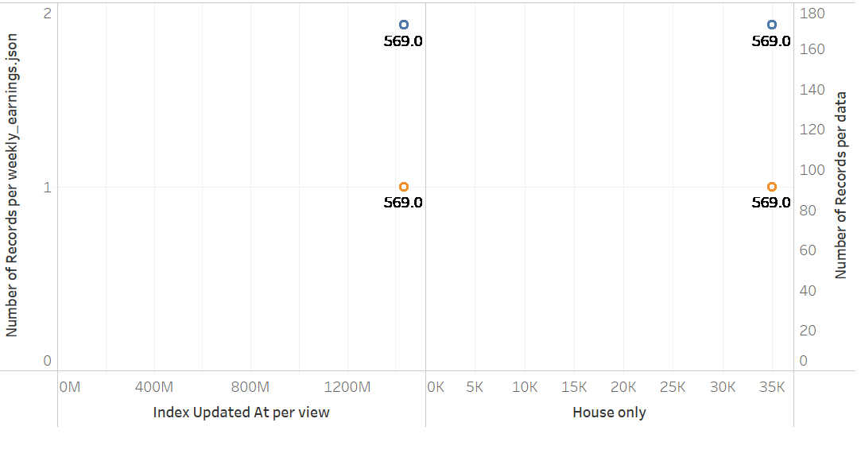
Compare the trend of house prices with earnings. *In case you want to plot monthly salary, be aware that the earnings value is per week.

Slide 14
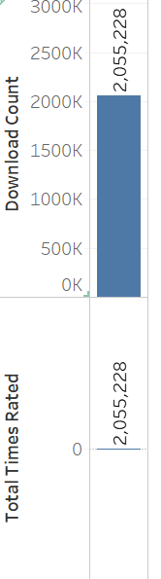
Spendings

Slide 15
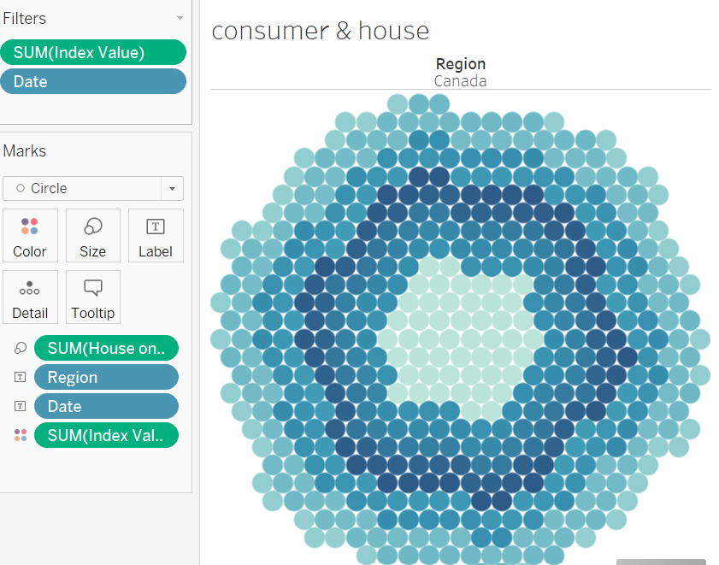
Plot consumer_index together with housing_price_index and fit the regression line between them. Can we predict consumer_index from the housing_price_index?

Slide 16
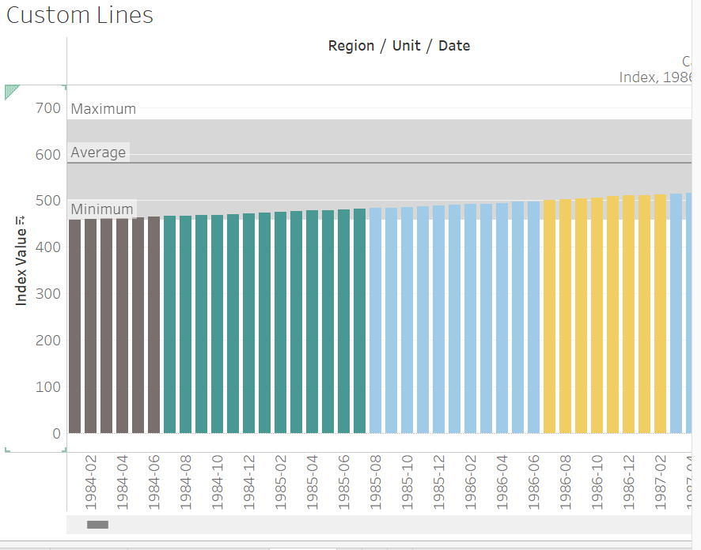

Slide 17
Some redundant data
Will explore more areas if had more time.

Slide 18
THANK YOU

